Slide 1
SACK GARDEN
April 2016

Slide 2
Firstly – the irrigation system

Slide 3
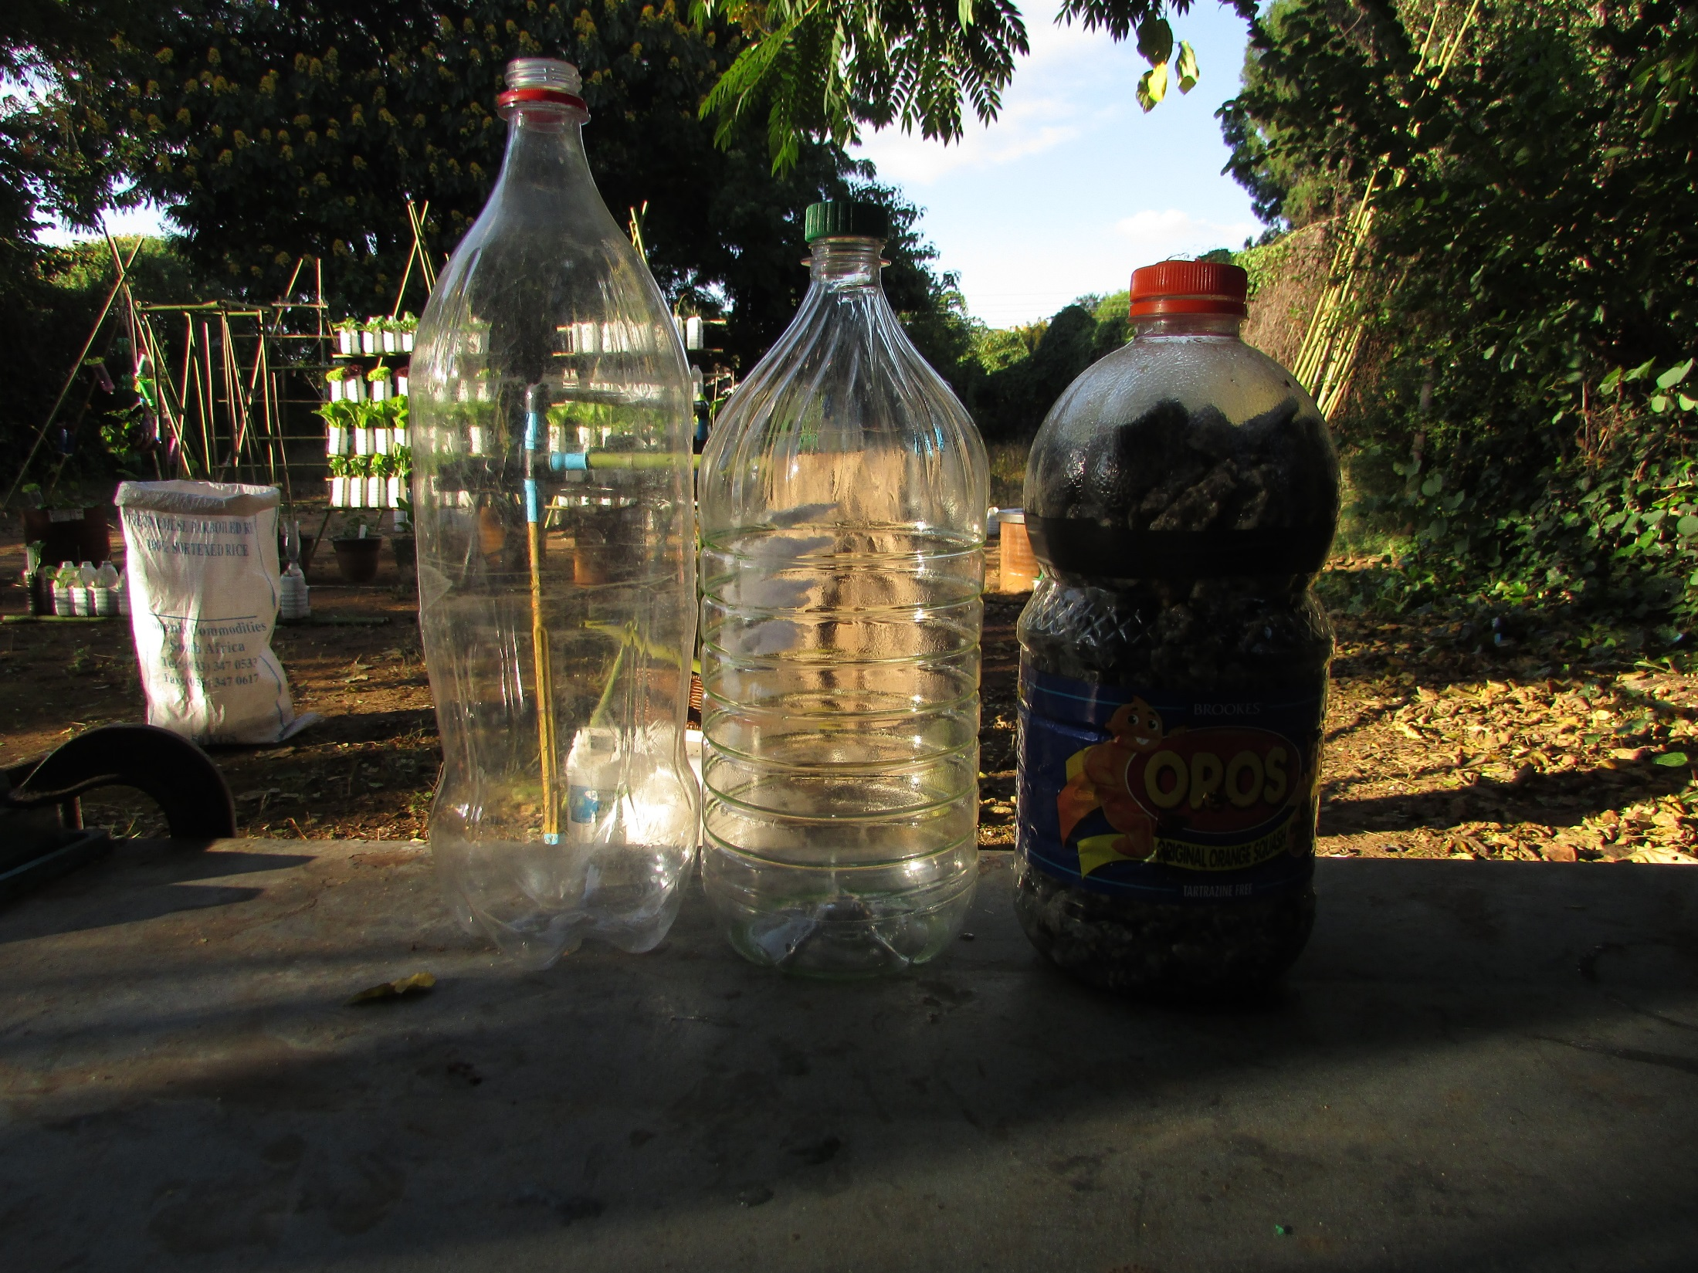
3 x 2L bottles
Top
Middle
Bottom
(Big cap)

Slide 4
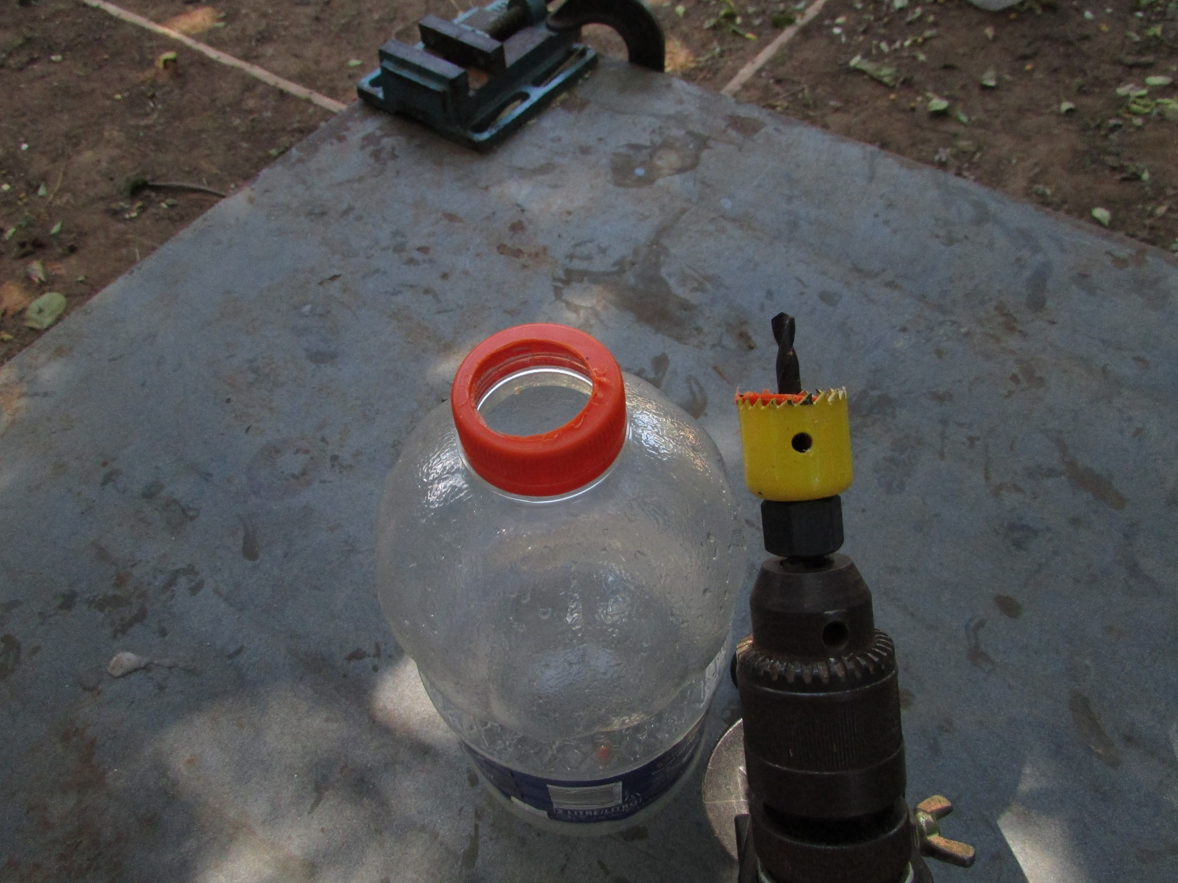
Bore a 28 mm hole in the
cap of the bottom bottle

Slide 5
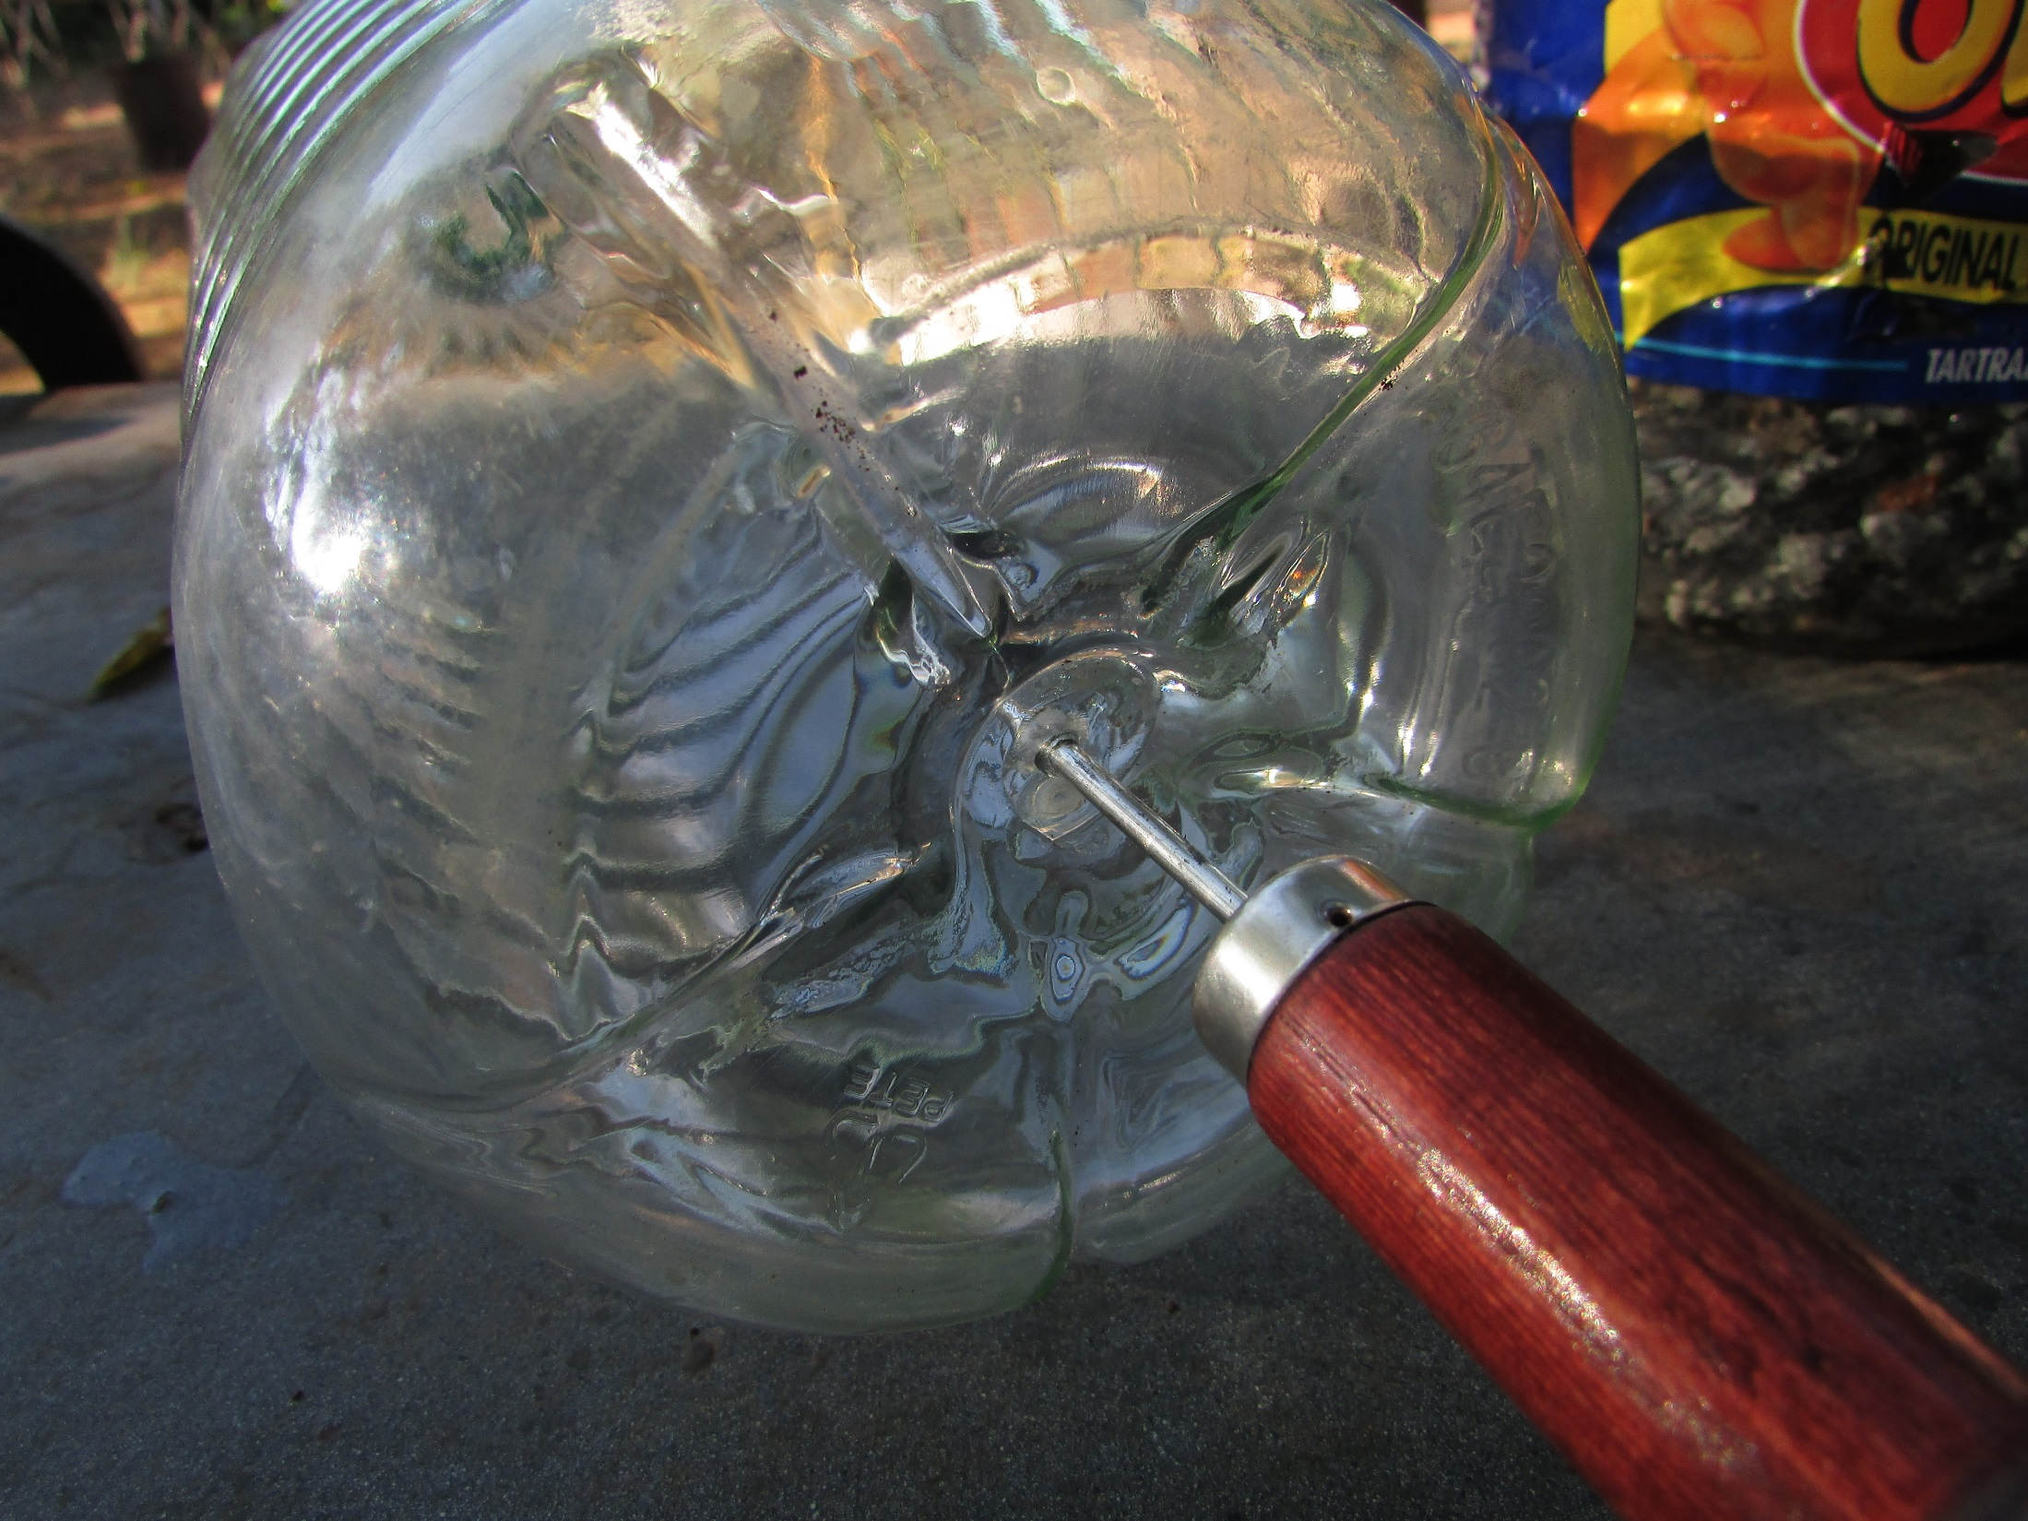
Punch a central guide hole in
the base of the middle bottle

Slide 6
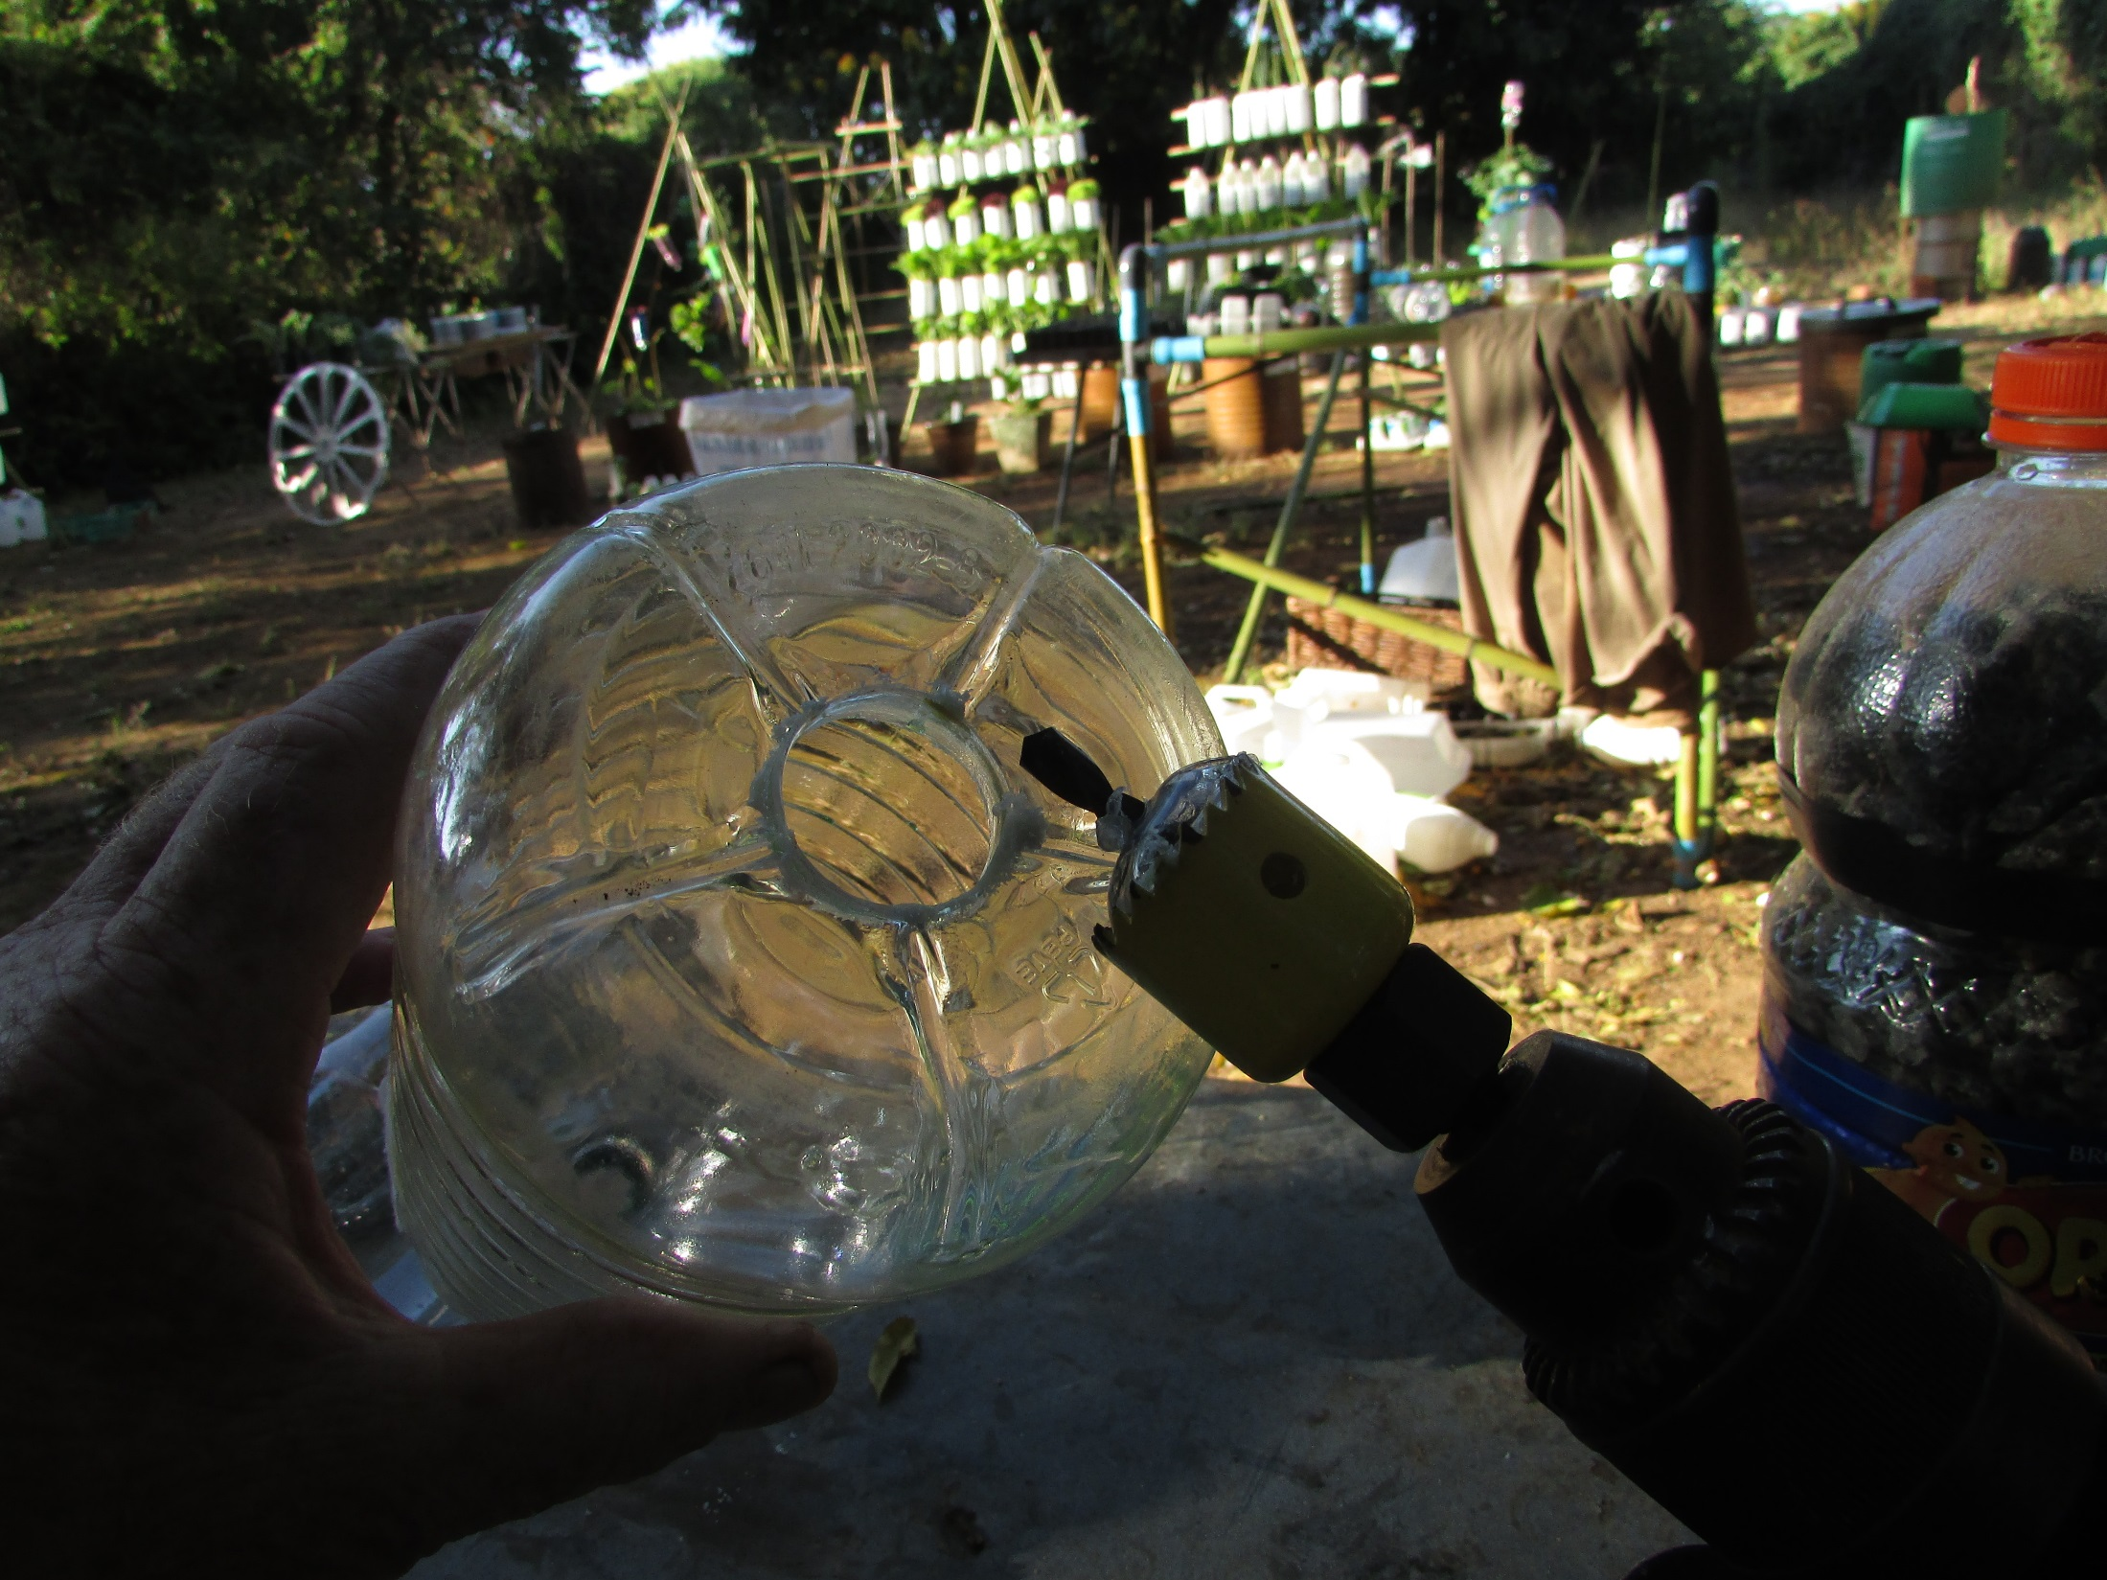
Bore a 28 mm hole

Slide 7
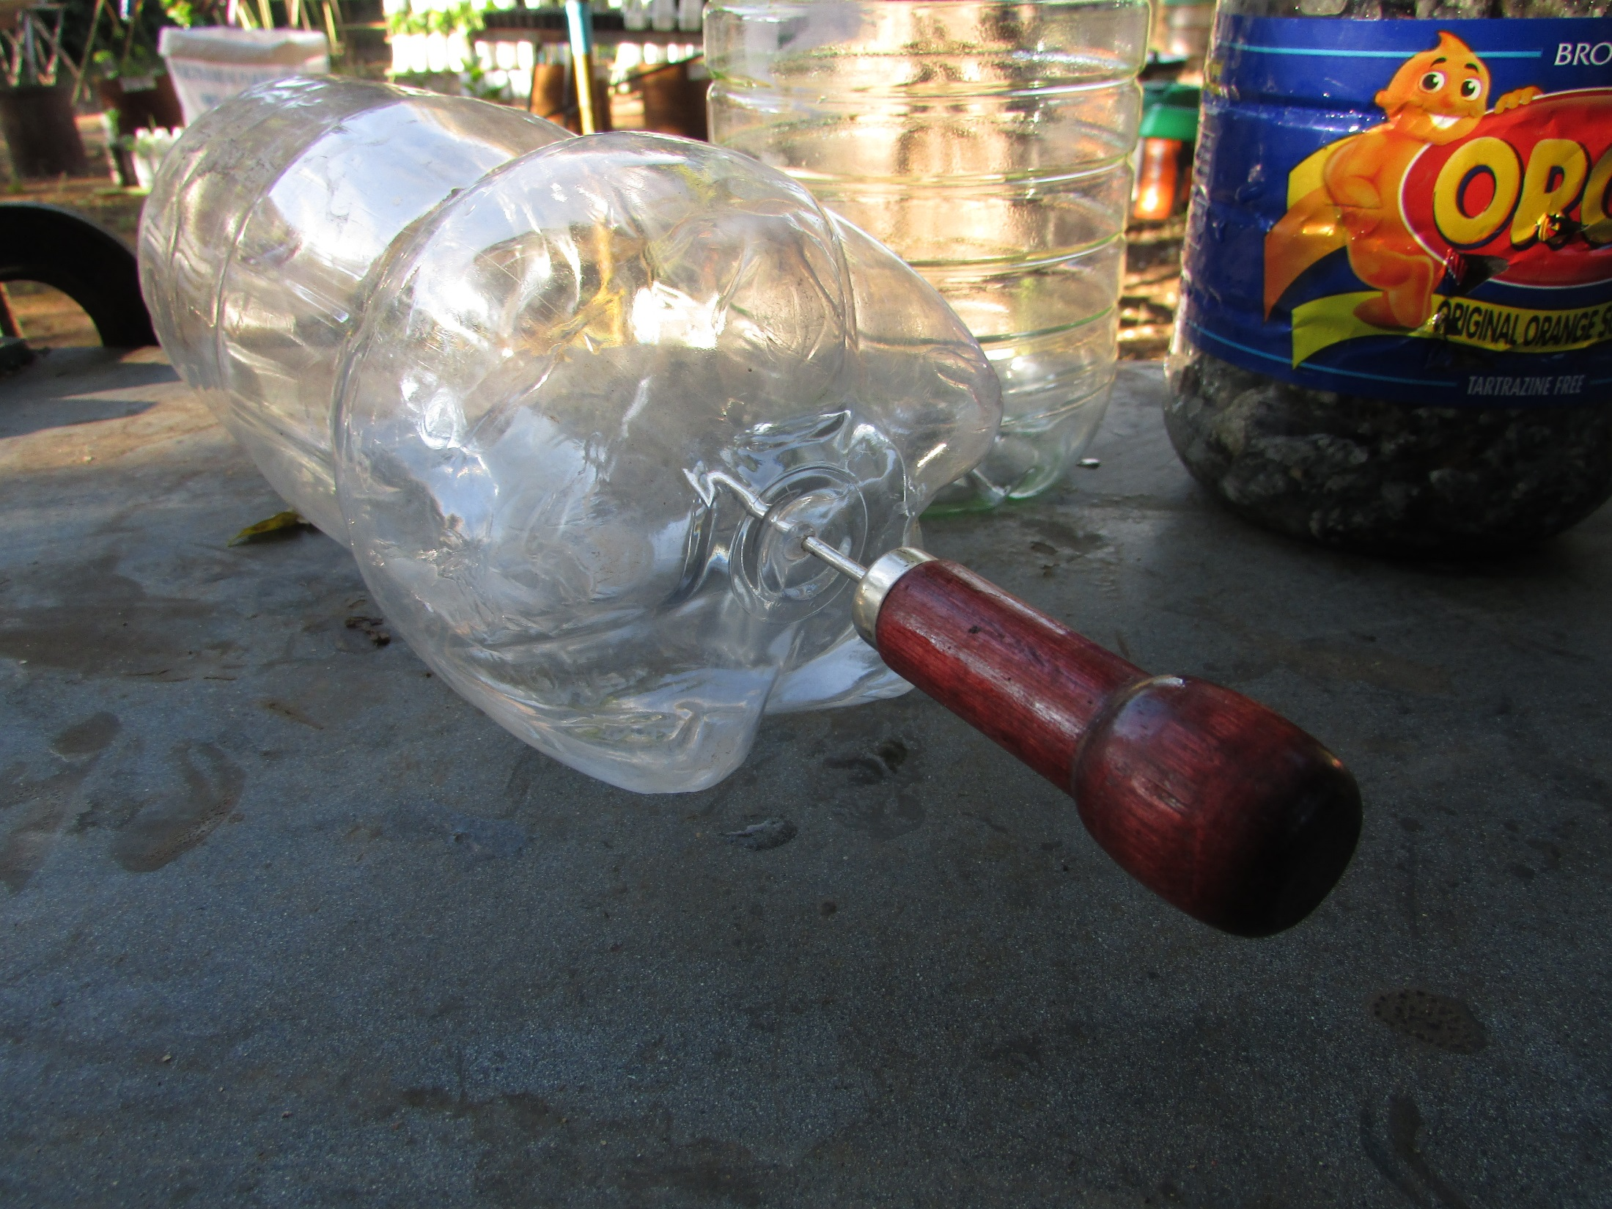
Punch a guide hole in the
base of the top bottle

Slide 8
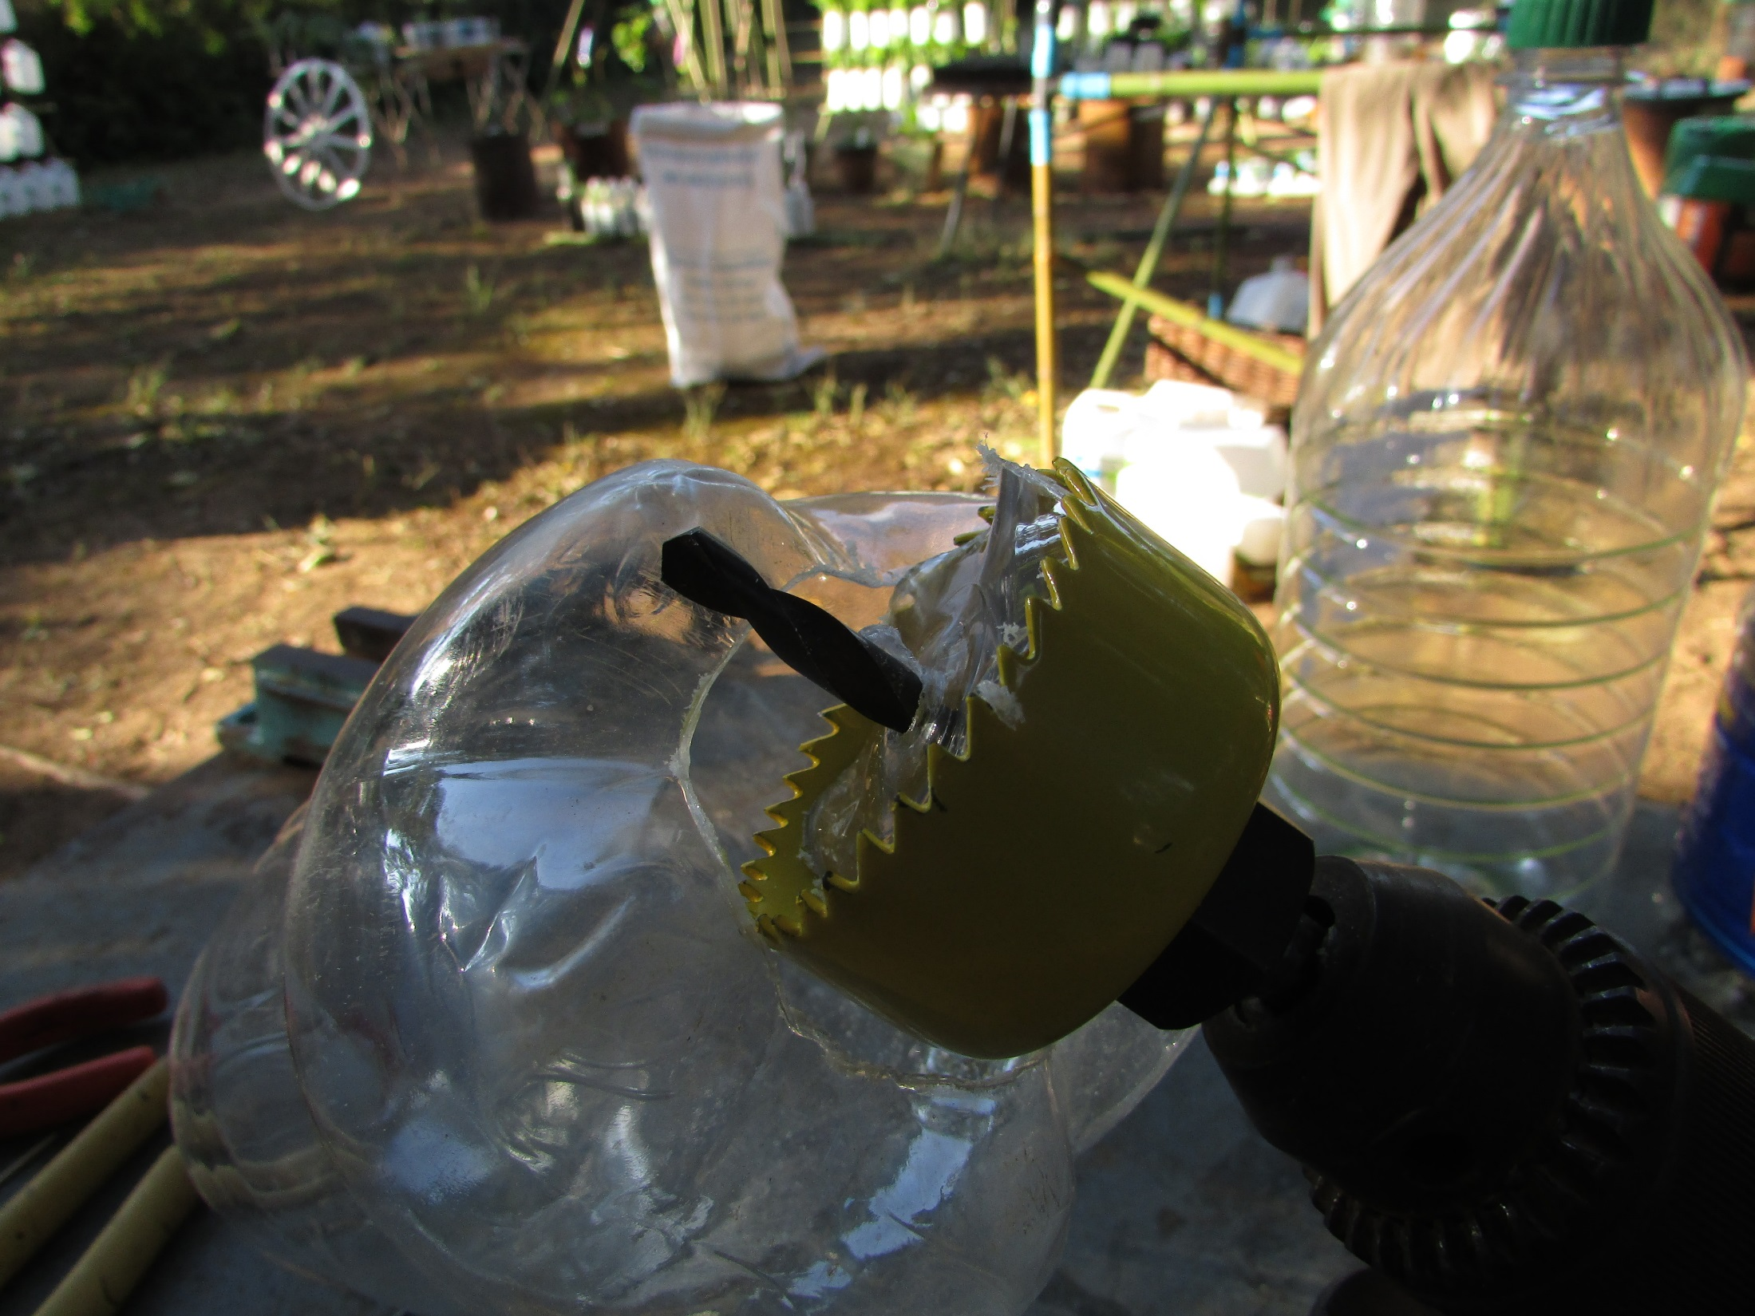
Bore a 52 mm hole

Slide 9
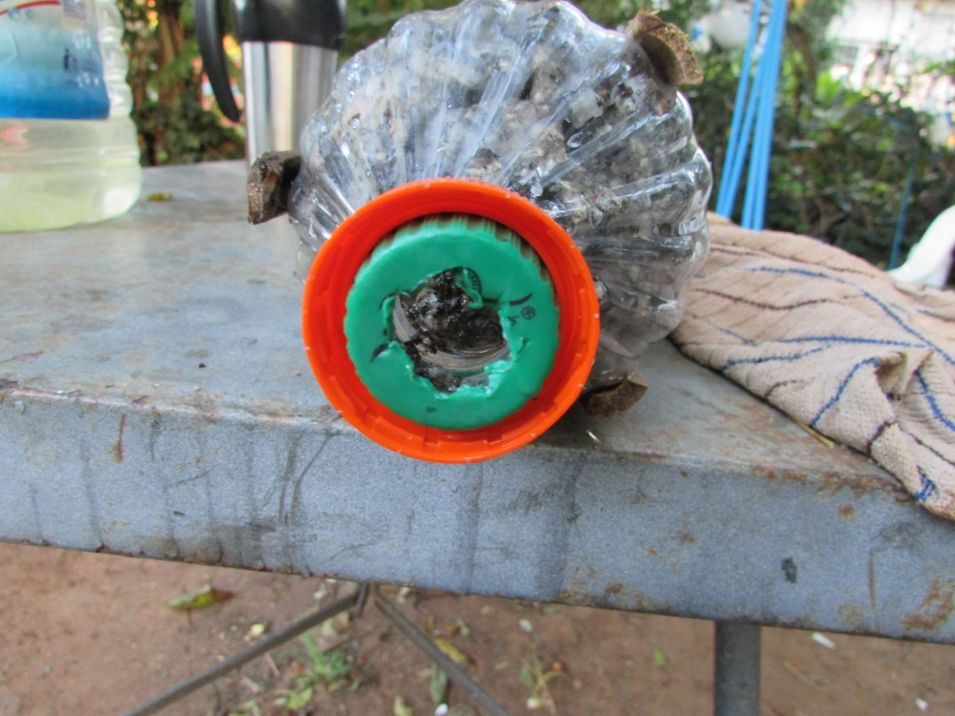
Hack a hole in the cap of the
middle bottle and screw on
the bottom bottle’s cap

Slide 10
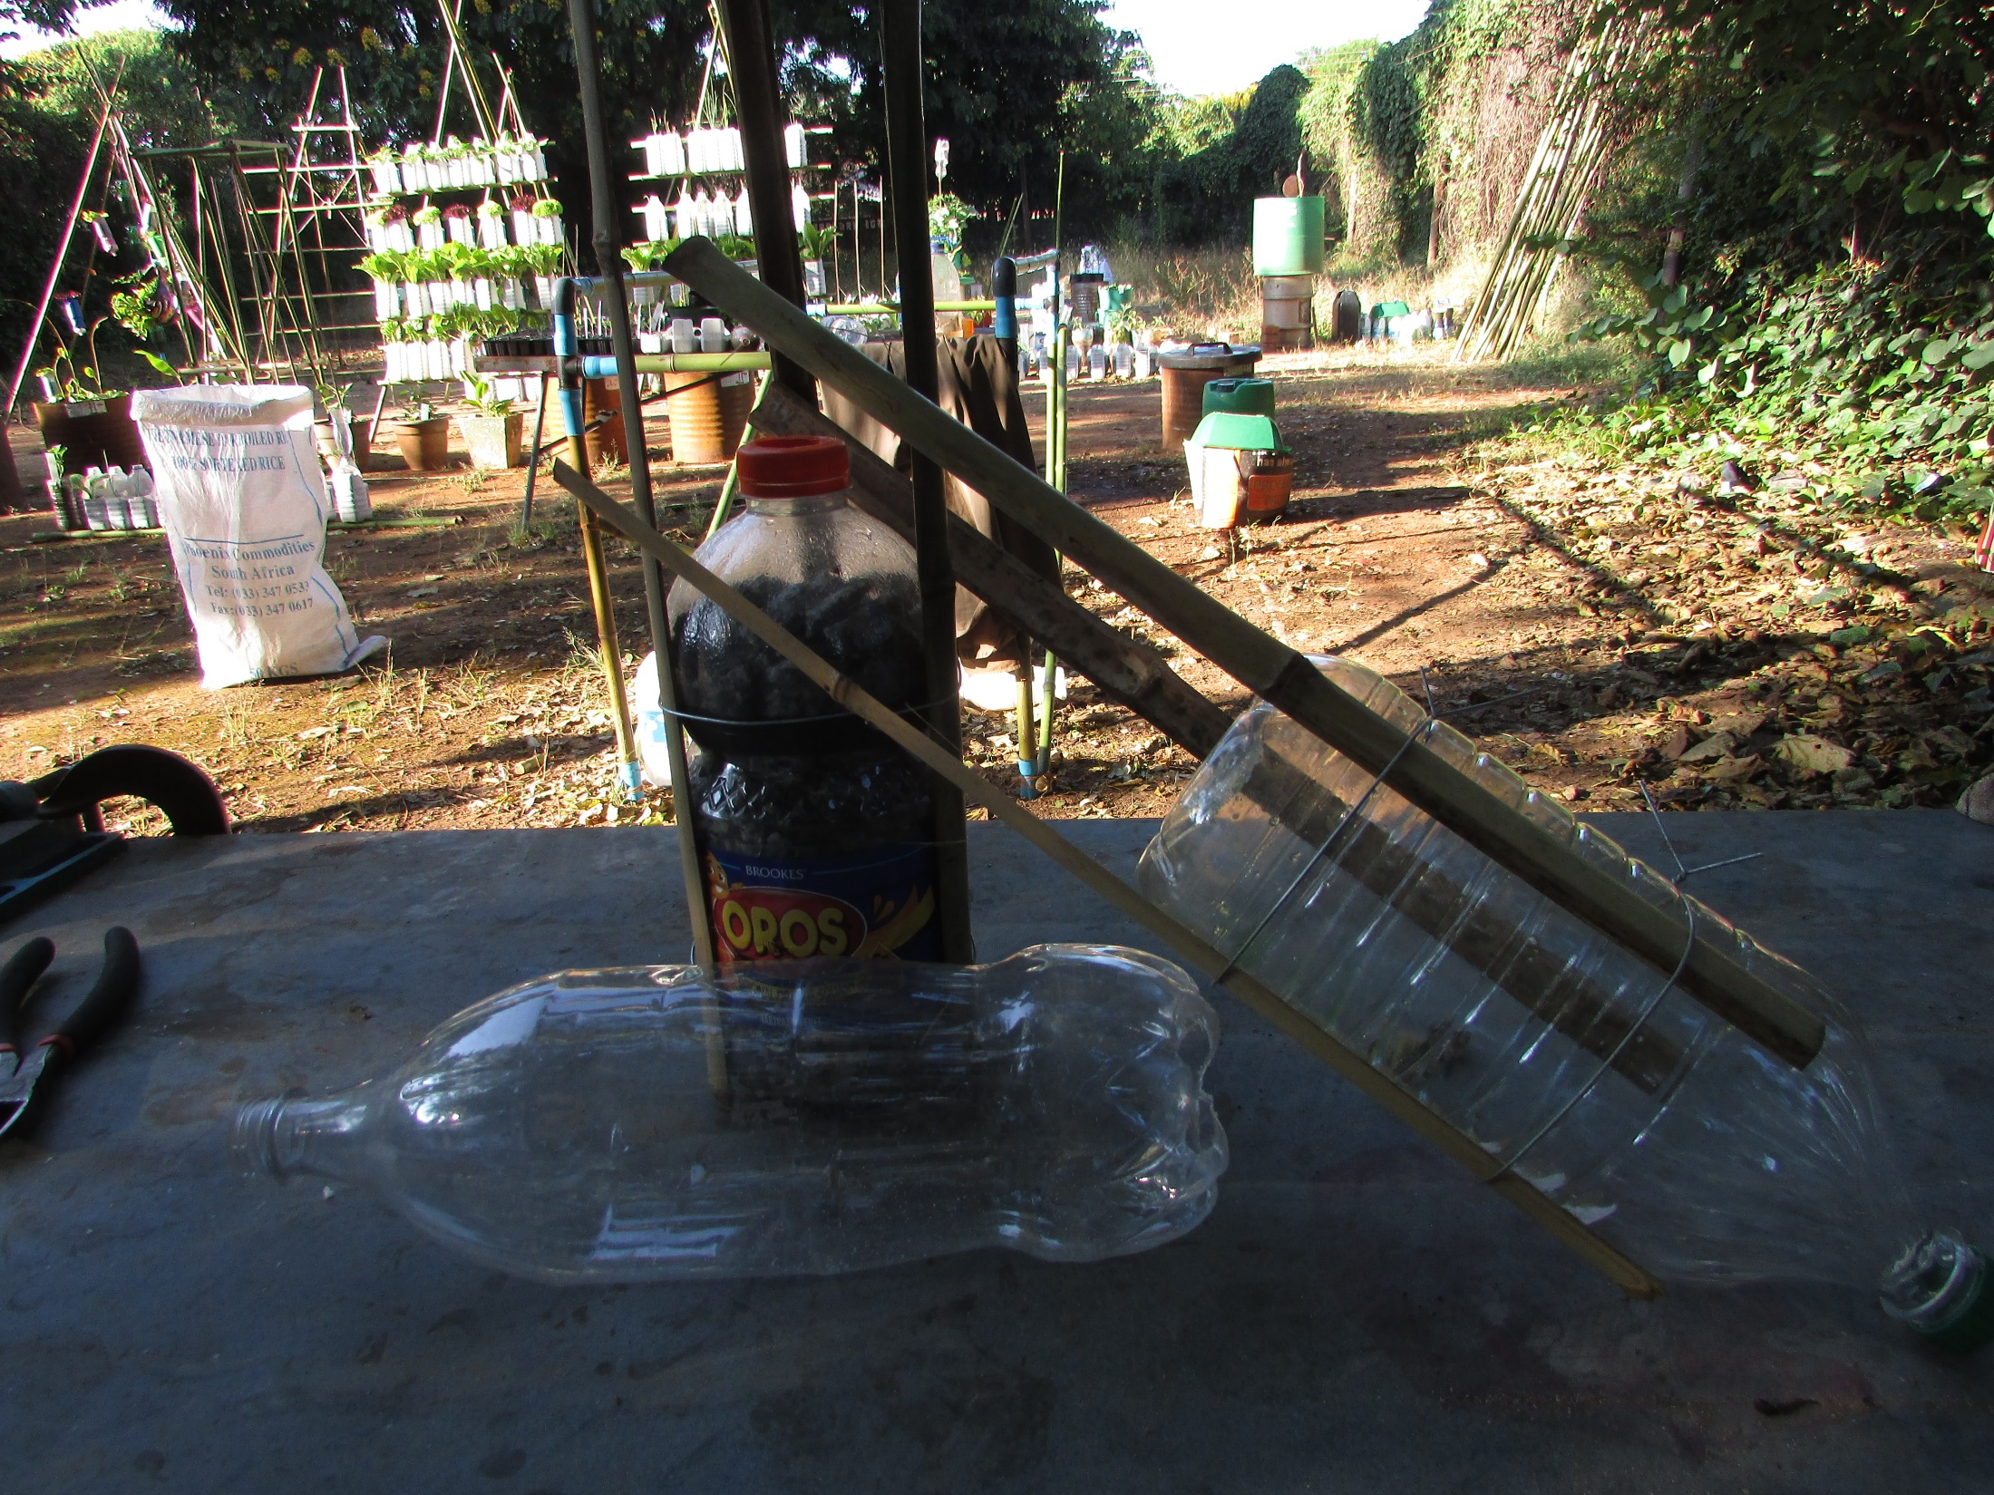
Tie on three splints to the
bottom two bottles

Slide 11
Fill the bottom two bottles
with gravel or rocks

Slide 12
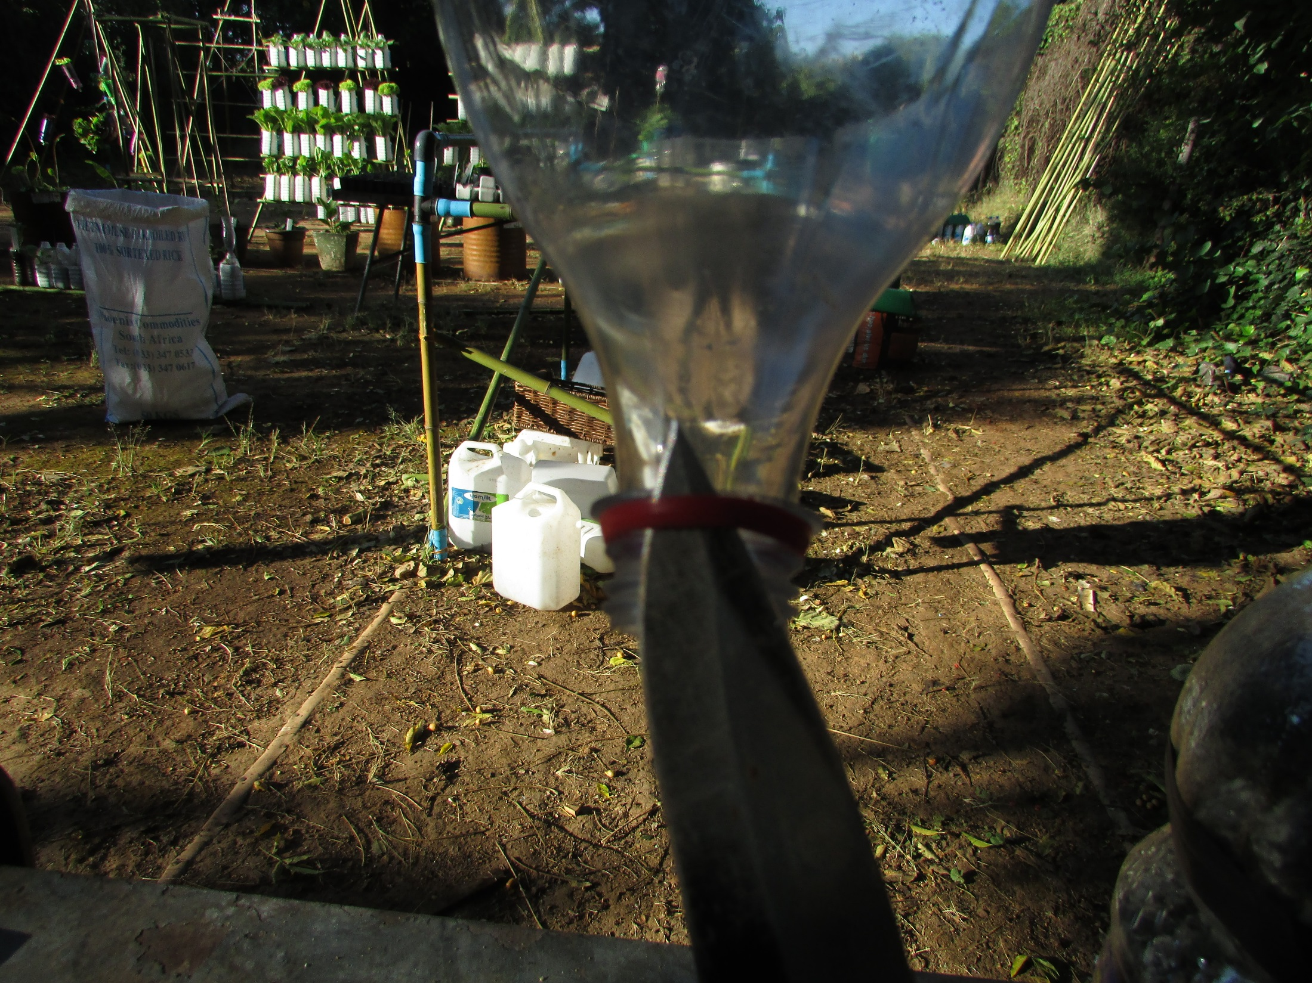
Remove this

Slide 13
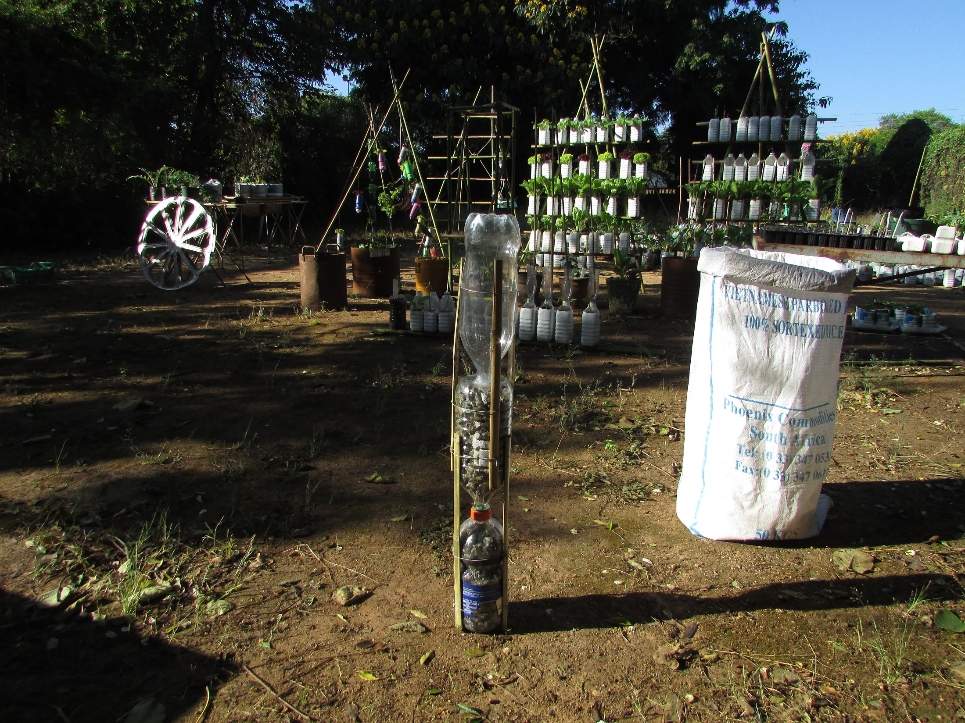
Connect the three bottles
Pin prick
irrigation
Silicon sealer
holes
N, S, W + E

Slide 14
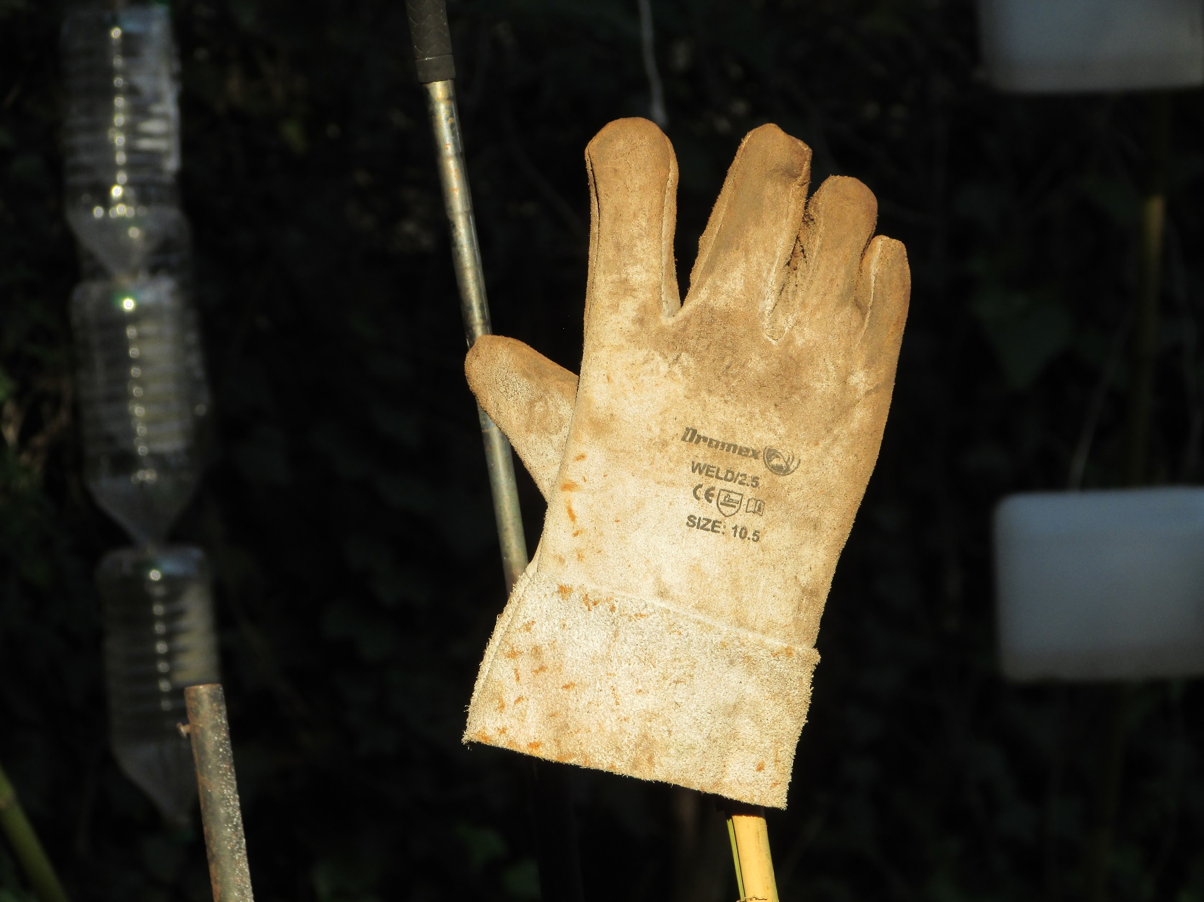
Have a break!

Slide 15
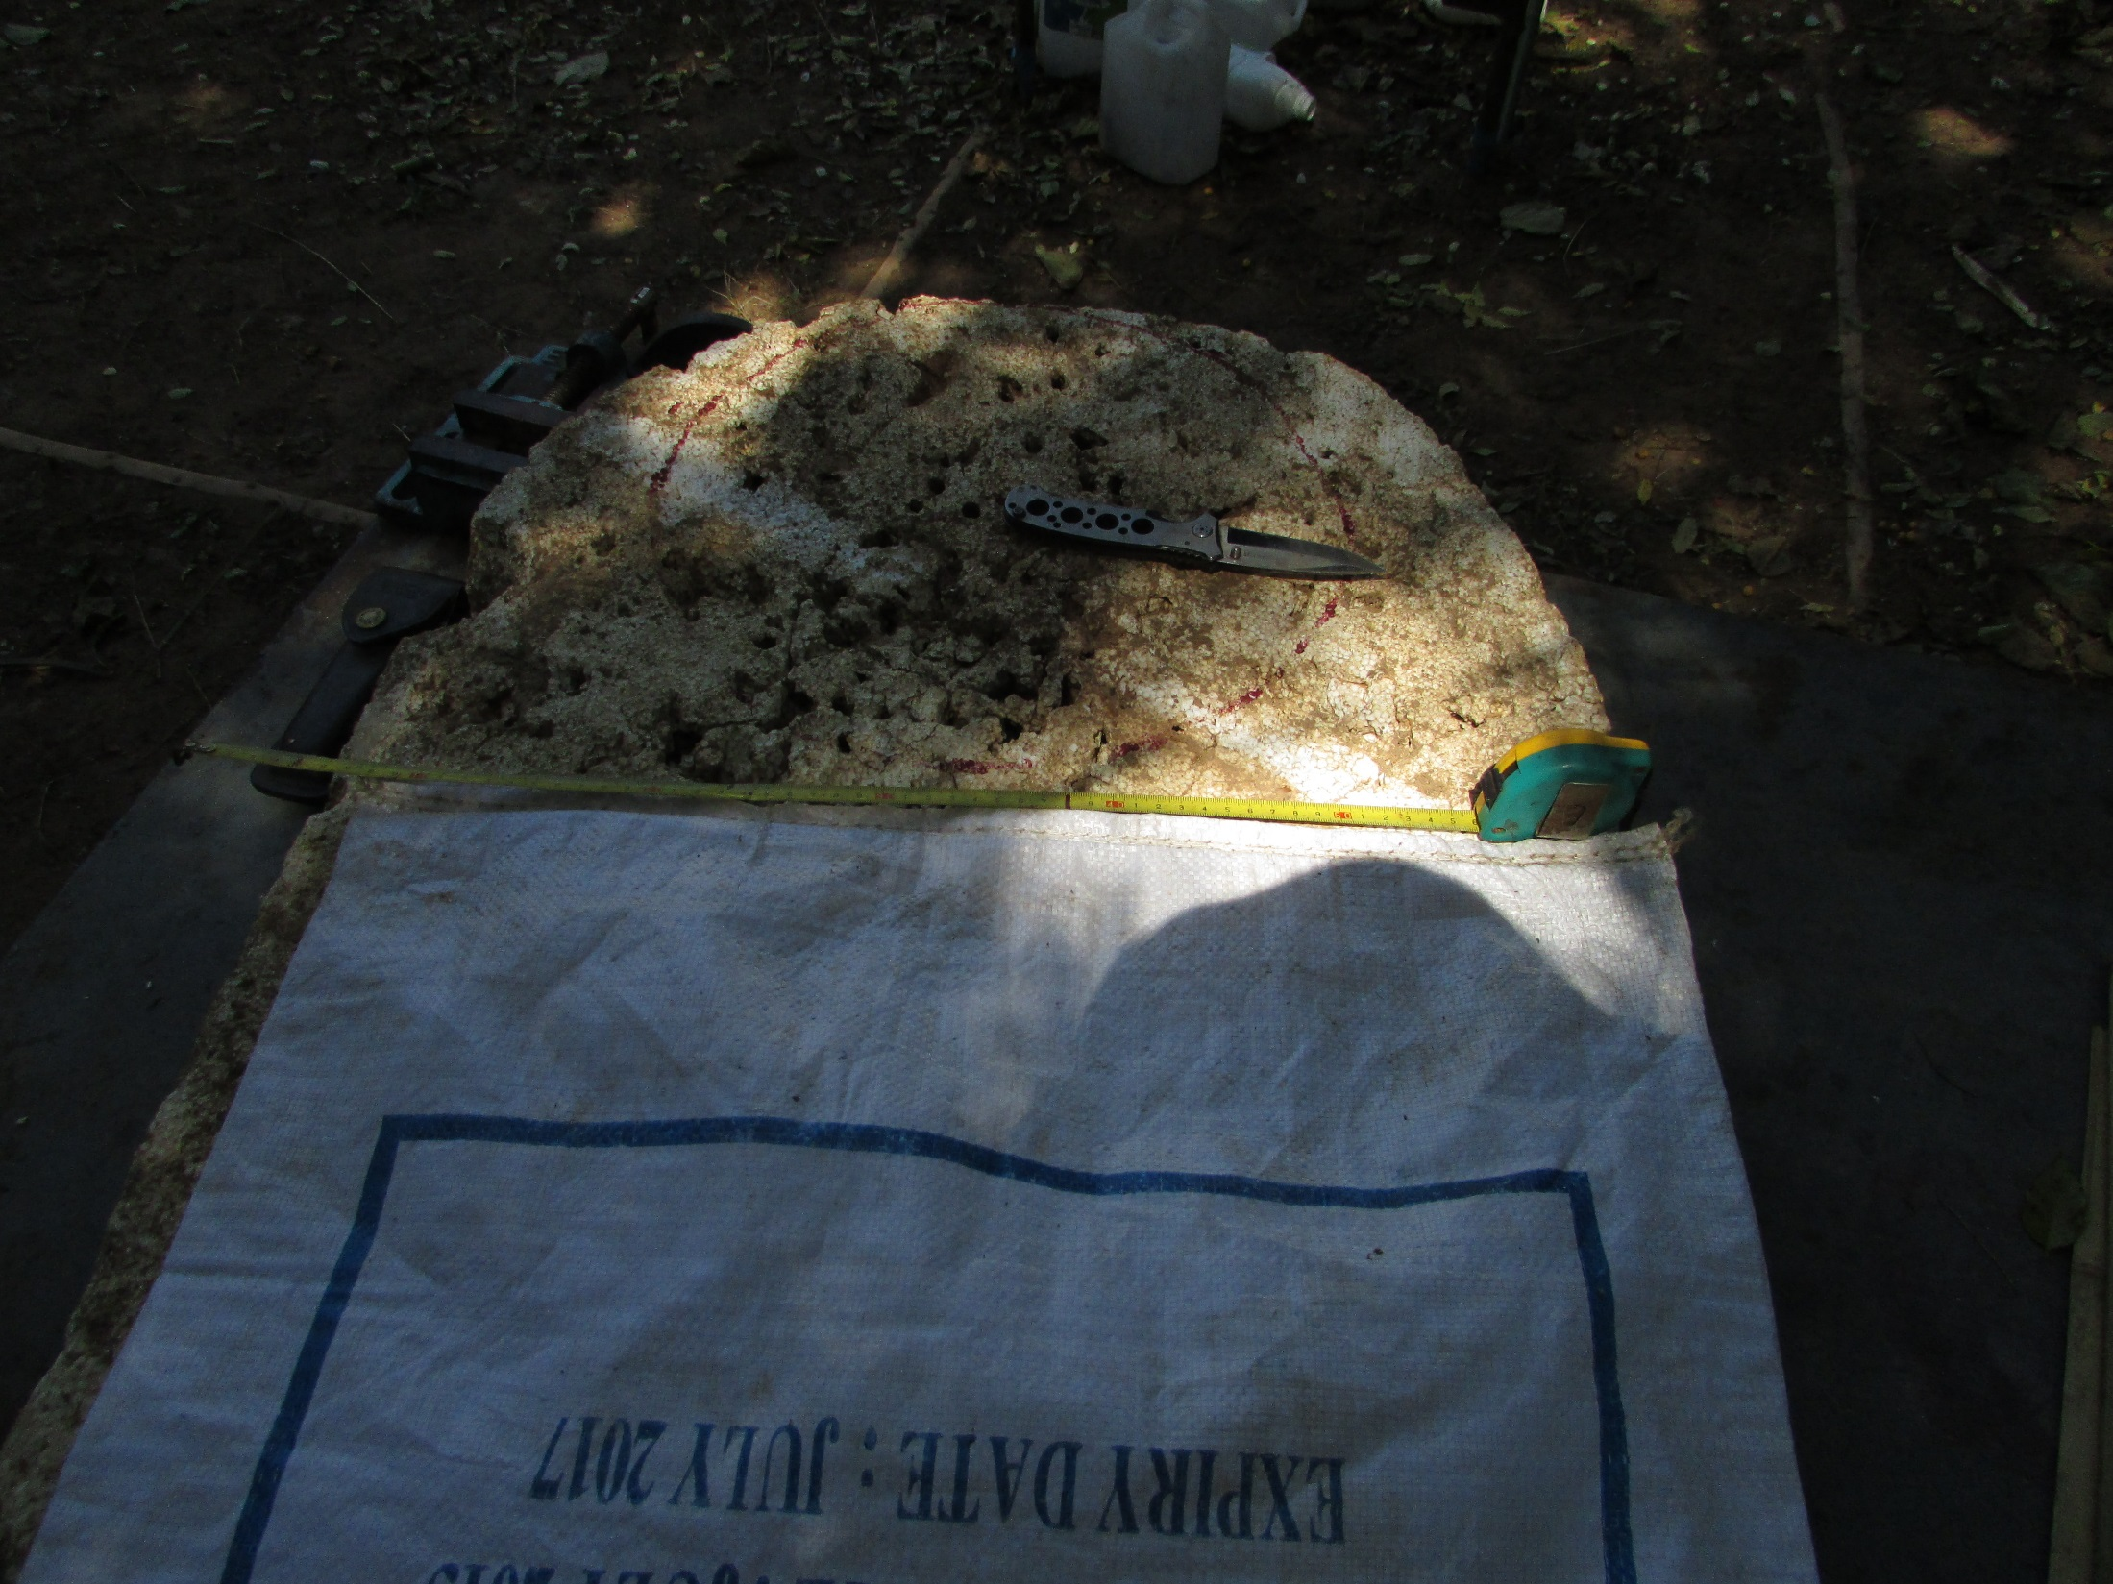
Measure the width of the
sack and divide by pi

Slide 16
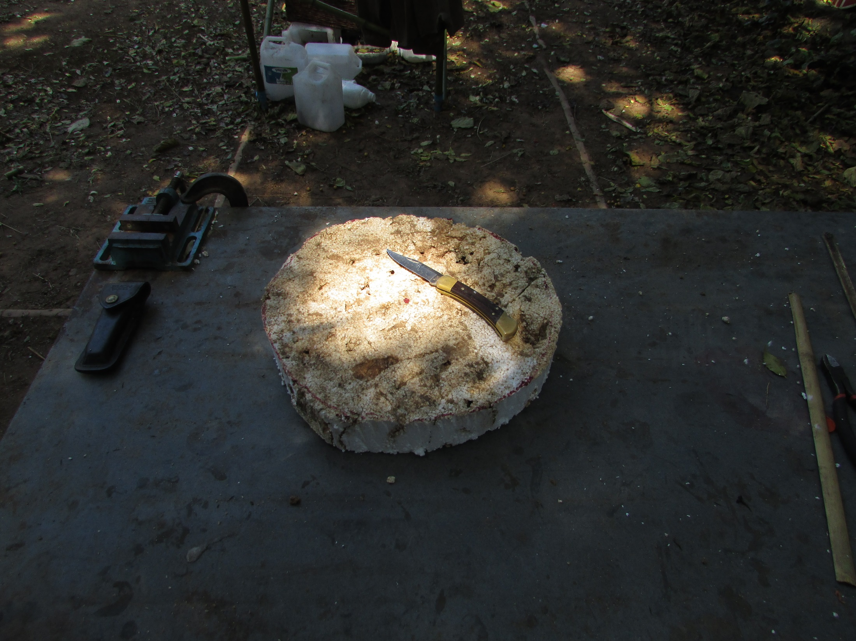
Cut out a base plate of
that diameter

Slide 17
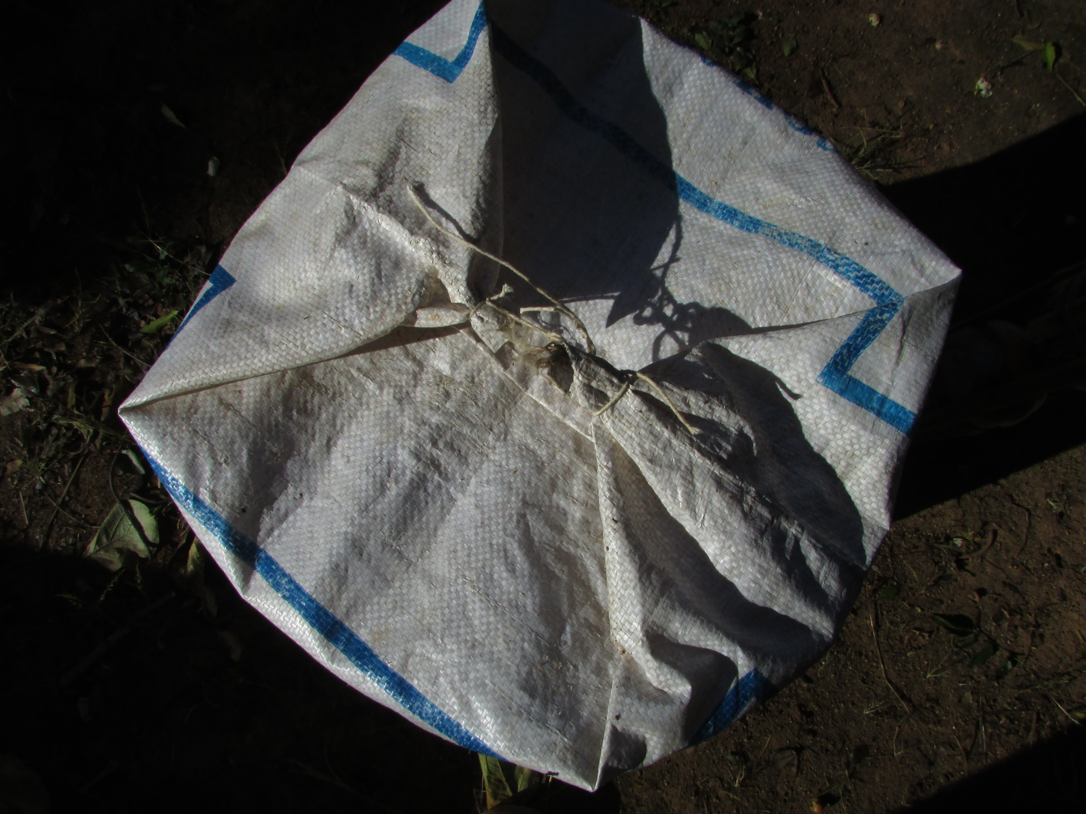
Place the base in the sack and
tie the floppy corners together

Slide 18
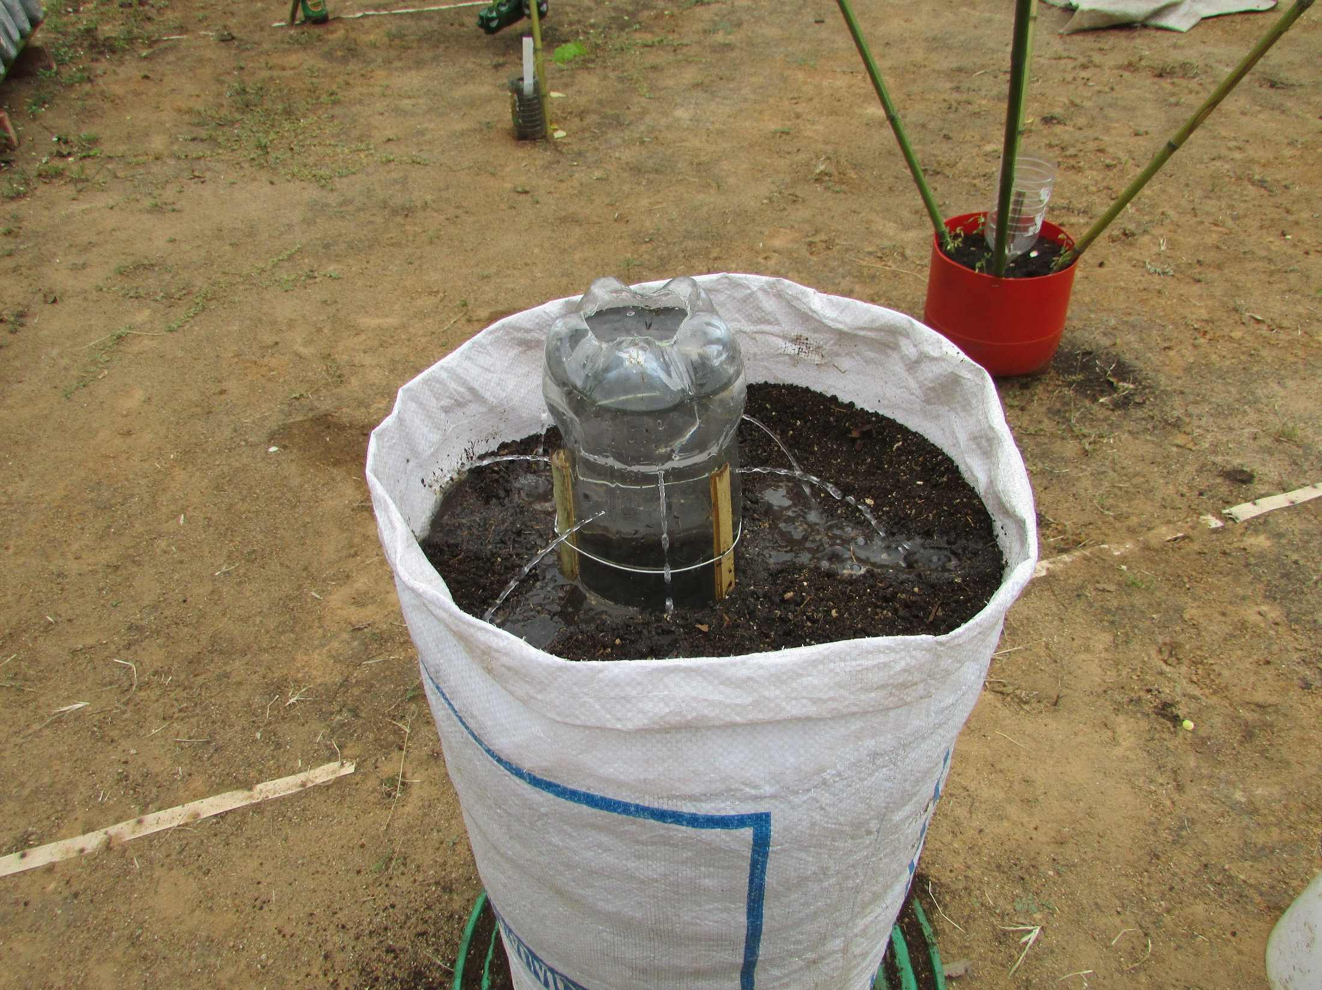
Fill with best potting soil

Slide 19
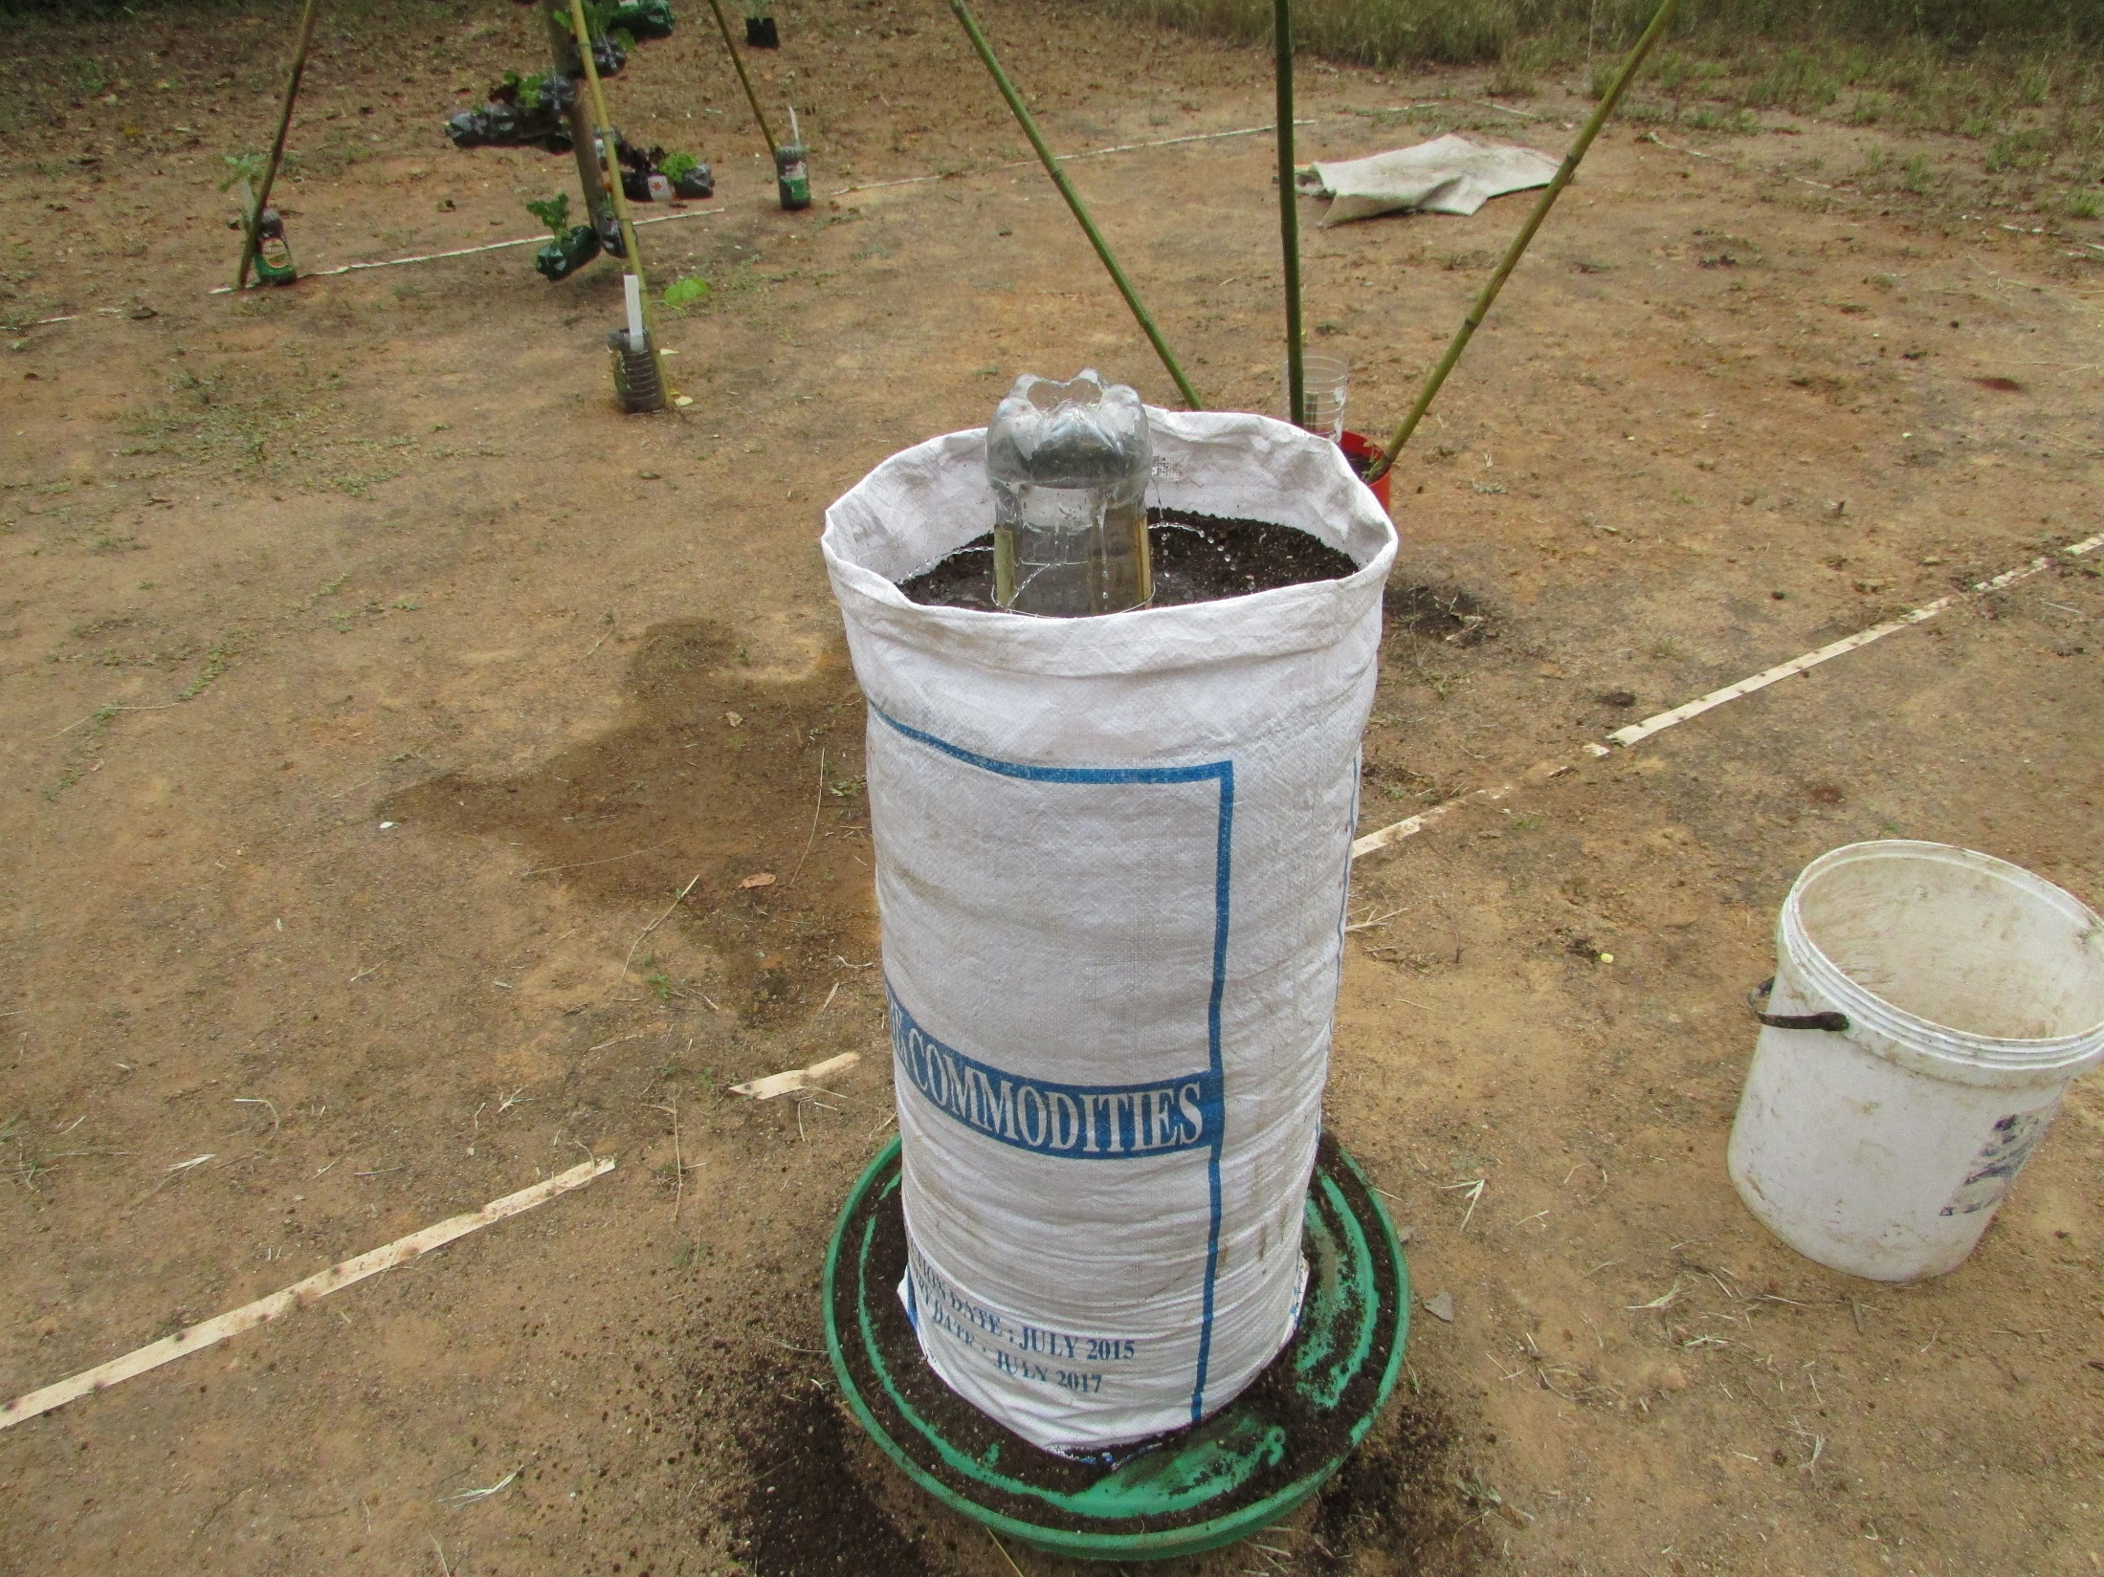
Irrigate

Slide 20
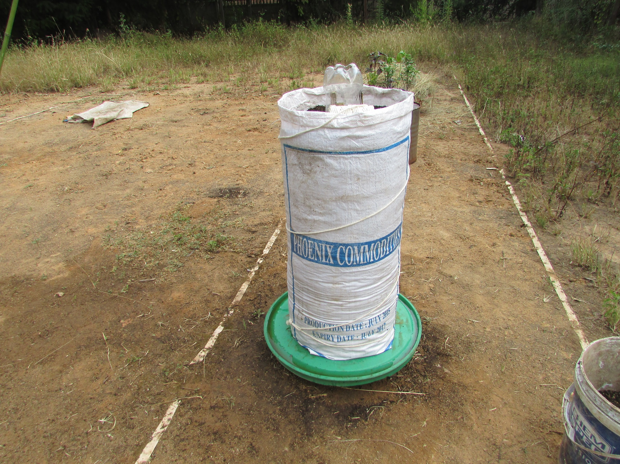
Mark out planting stations

Slide 21
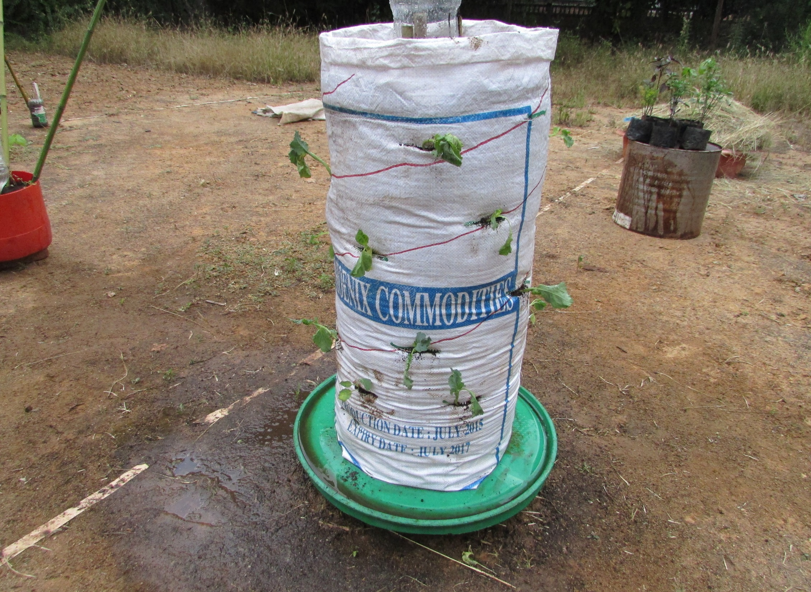
Cut slits and plant seedlings

